Slide 1
Bioproduction Data Platform Sample Program
Shine Jose

Slide 2
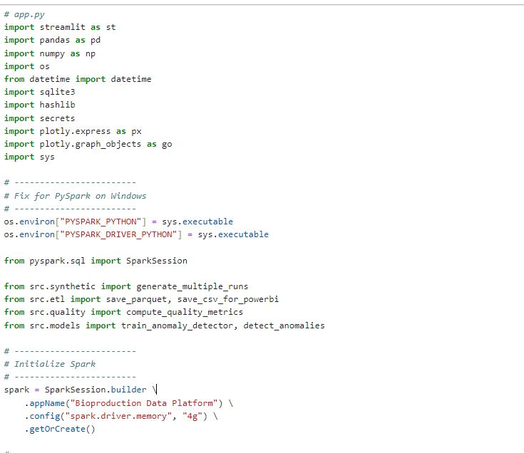
PACKAGES USED

Slide 3
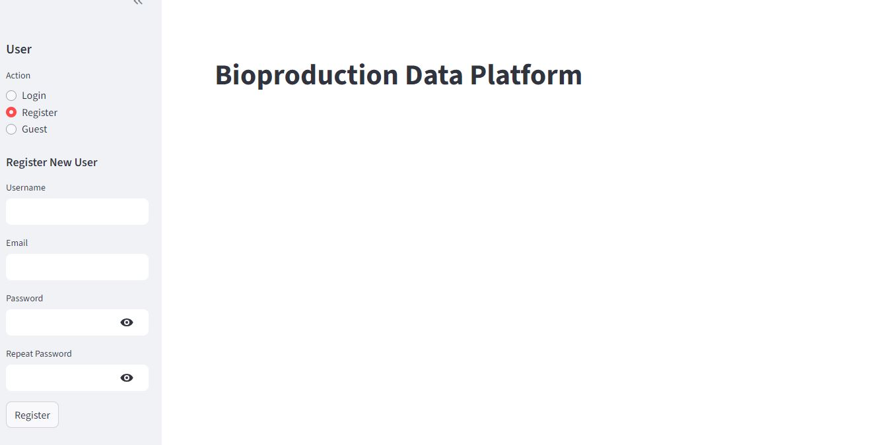
REGISTRATION

Slide 4
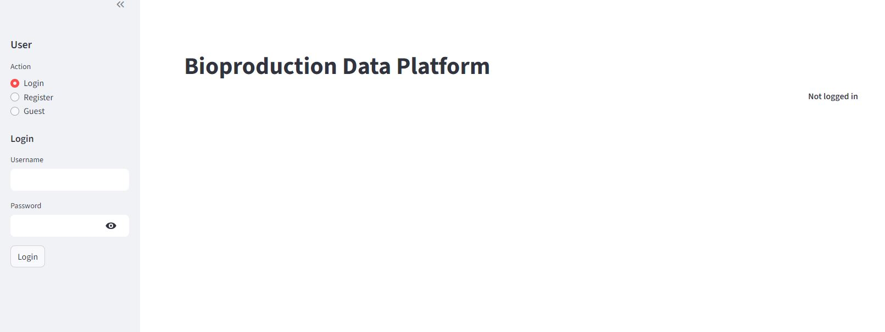
LOGIN

Slide 5
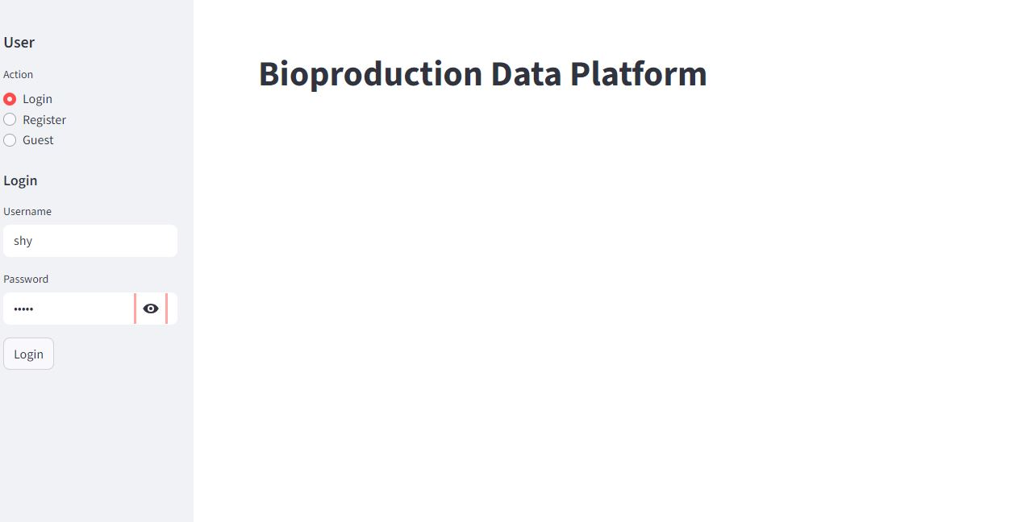
LOGIN

Slide 6
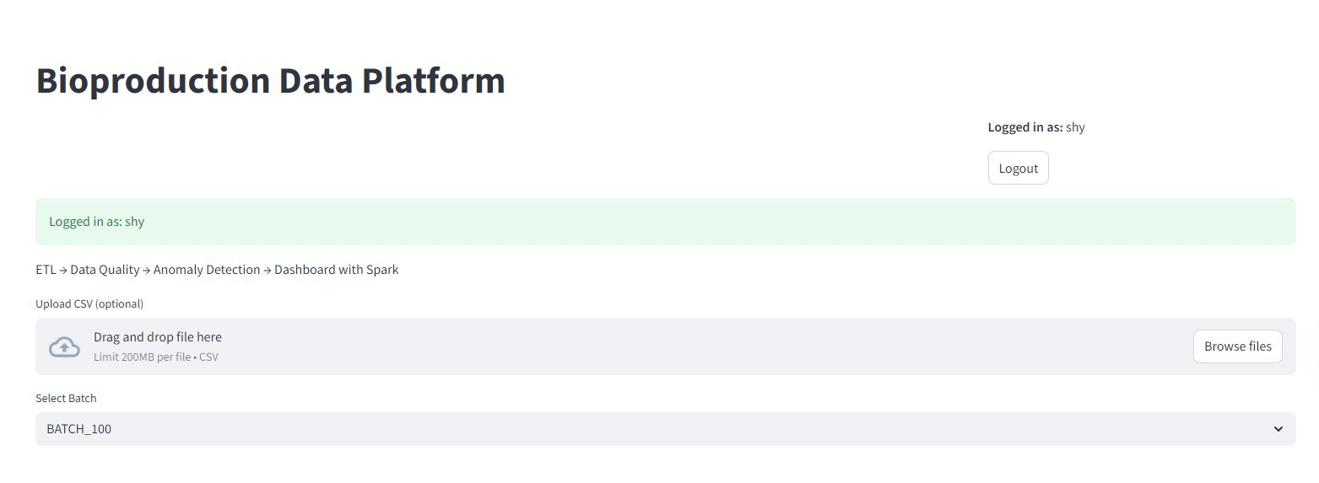
LOGIN

Slide 7
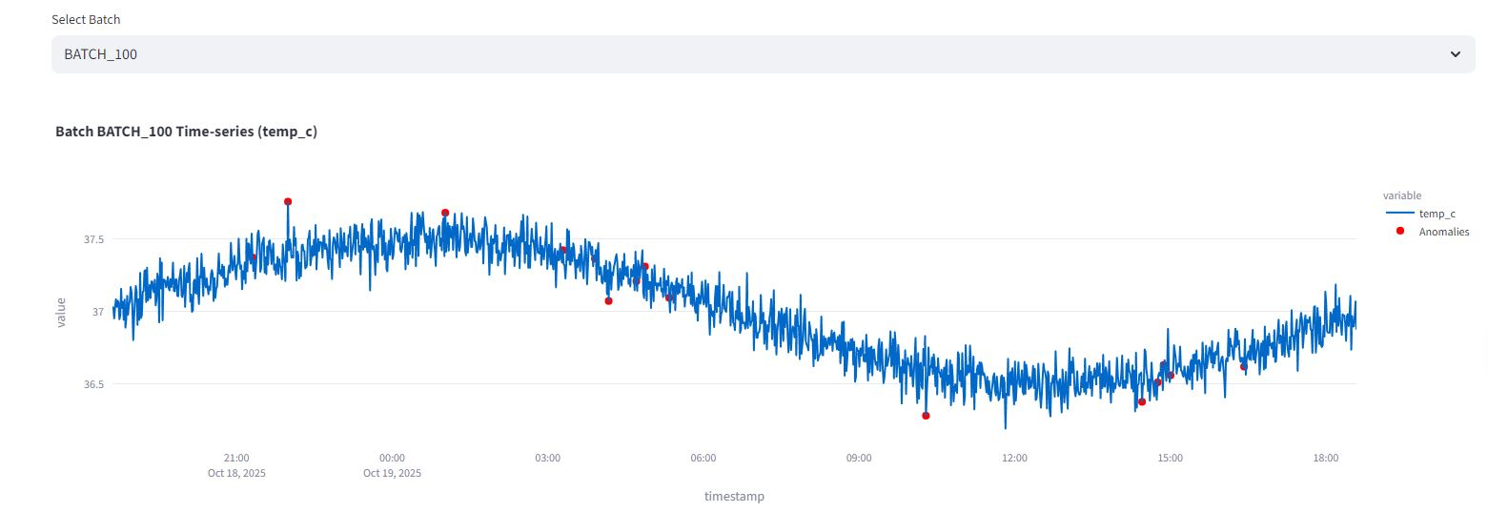
BATCH SELECTION

Slide 8
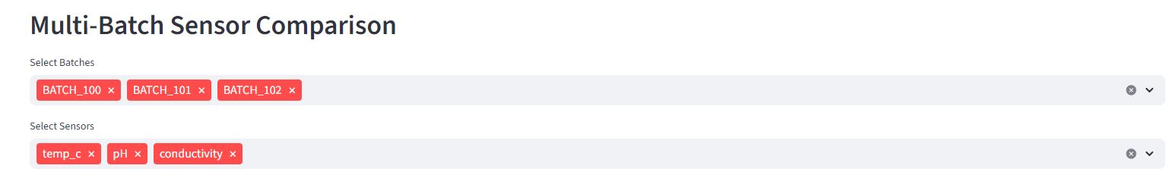
MULTI-BATCH SELECTION

Slide 9
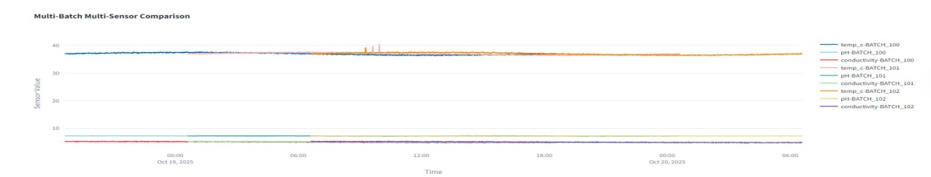
MULTI-BATCH SELECTION

Slide 10
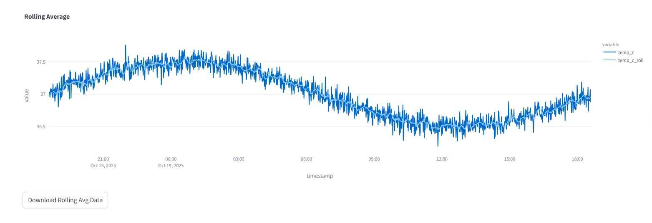
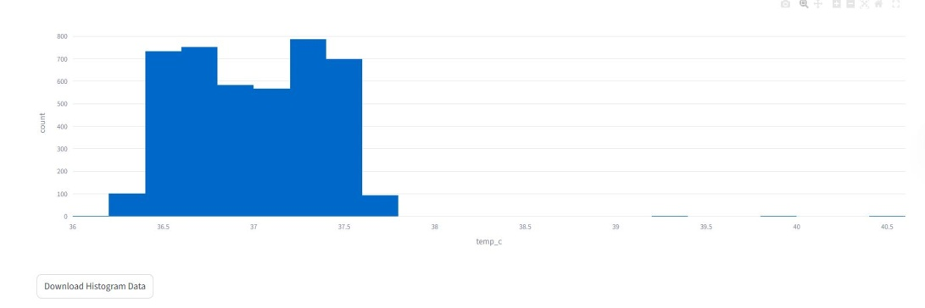
MULTI-BATCH SELECTION

Slide 11
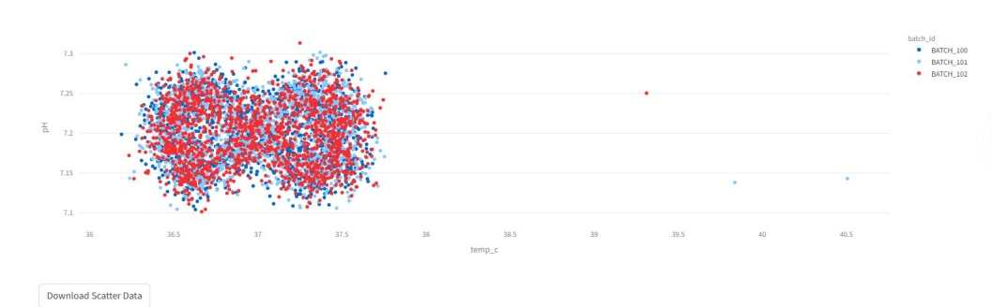
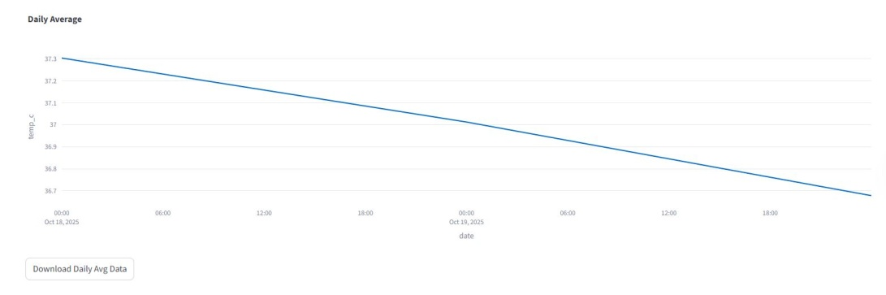
MULTI-BATCH SELECTION

Slide 12
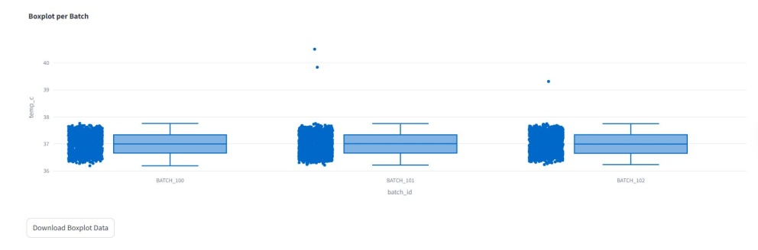
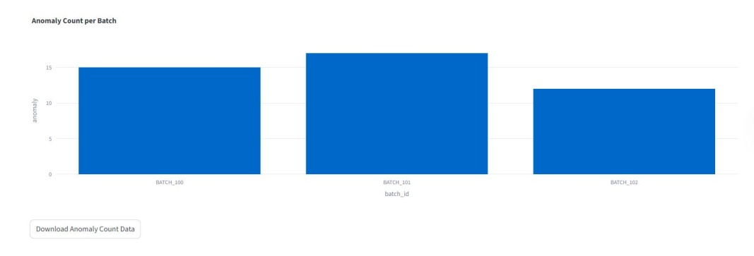
MULTI-BATCH SELECTION

Slide 13
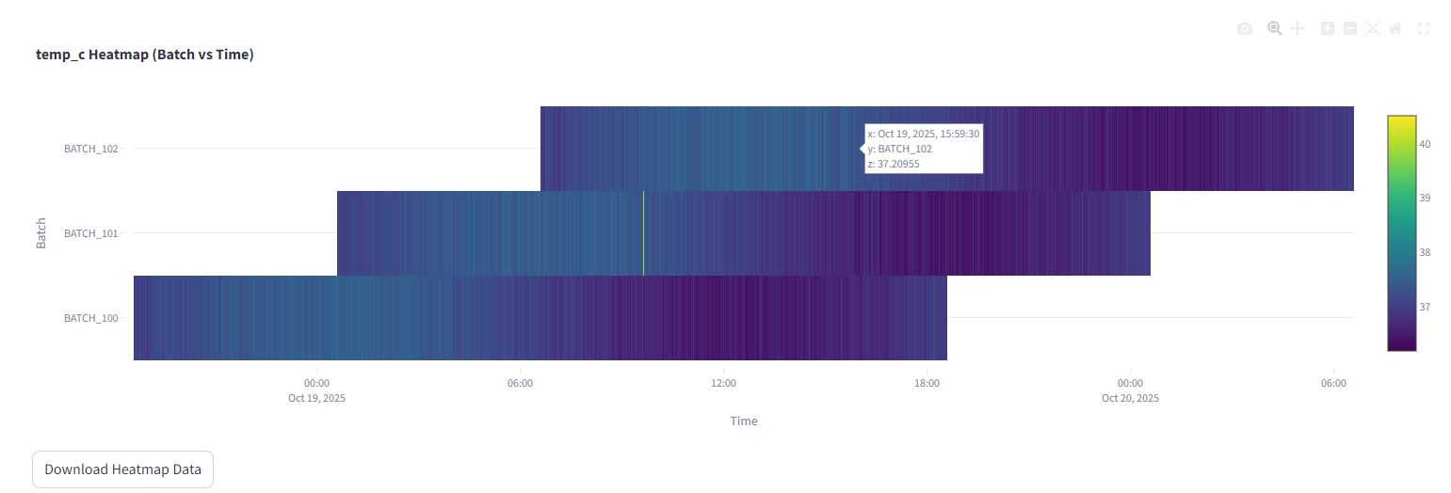
MULTI-BATCH SELECTION

Slide 14
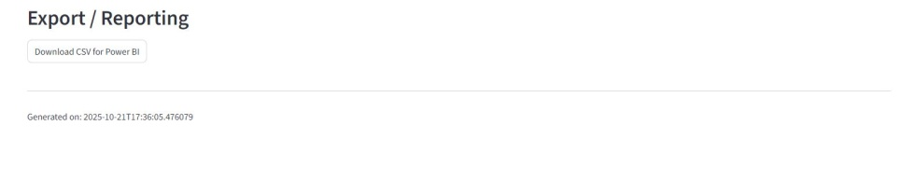
DOWNLOAD REPORTS
Connect Reports To POWER BI

Slide 15
DOWNLOAD REPORTS
Connect Reports To POWER BI

Slide 16
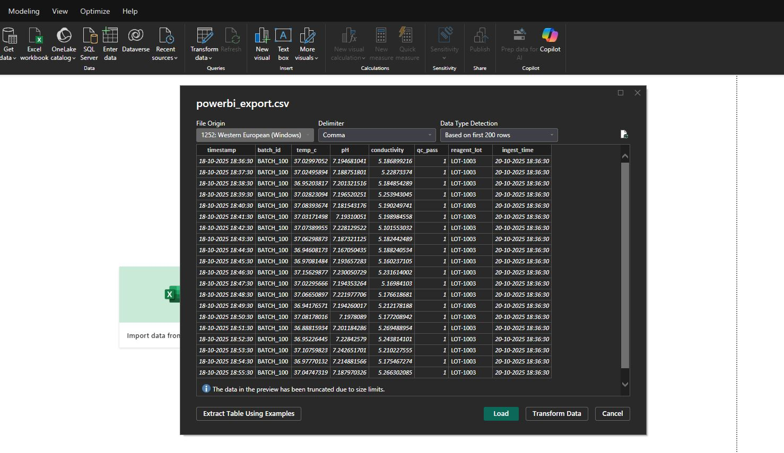
POWER BI
Connect Reports To POWER BI

Slide 17
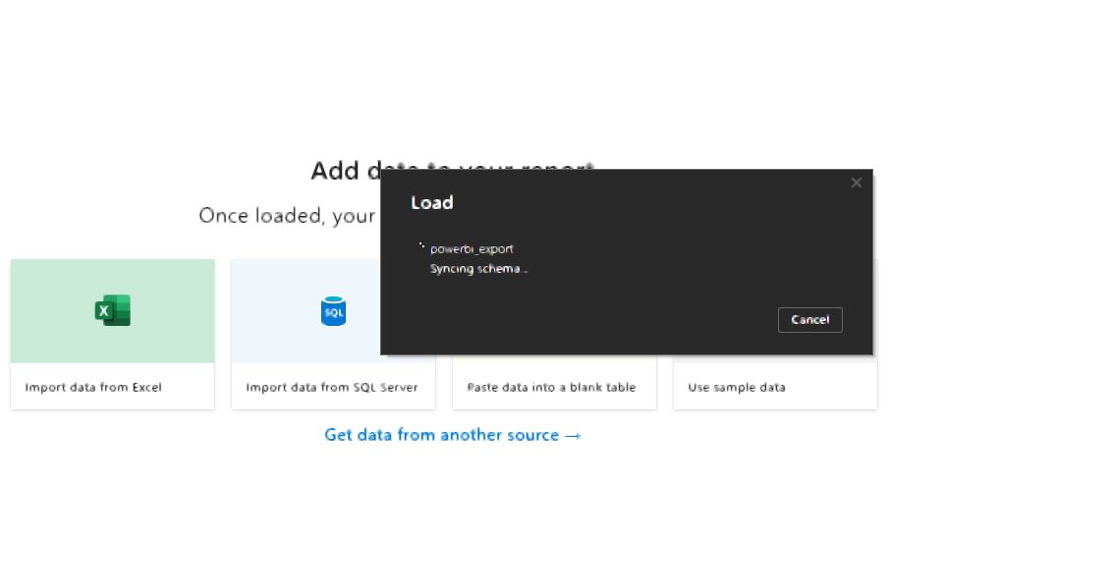
POWER BI
LOADING DATA

Slide 18
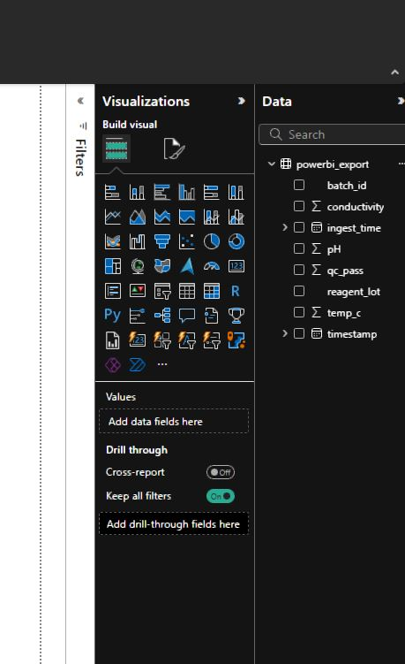
POWER BI
LOADING DATA

Slide 19
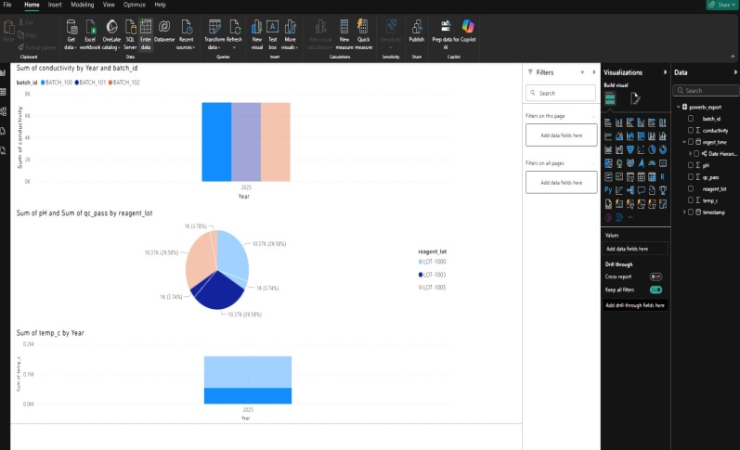
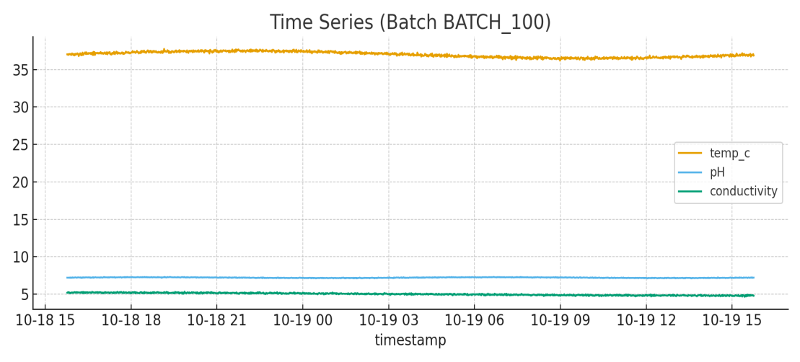
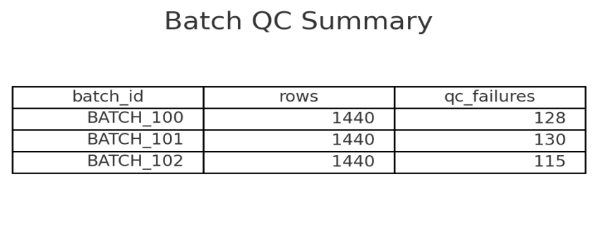
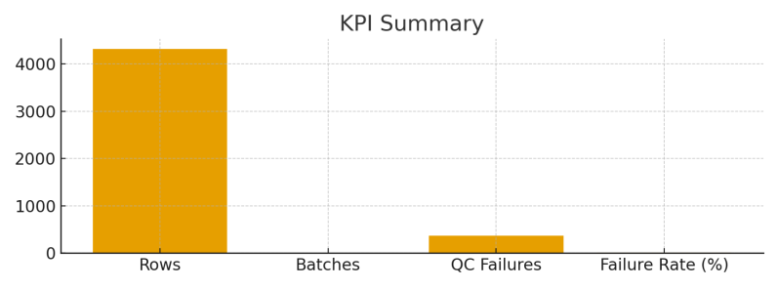
POWER BI
DATA PRESENTATION IN POWER BI

Slide 20
Thank You

